Slide 1
Software Requirements Analysis and
Specification

Slide 2
Value of a Good SRS
An SRS establishes the basis for agreement between the client and the supplier on what the software product will do
An SRS provides a reference for validation of the final product
A high-quality SRS is a prerequisite to high-quality softwar

Slide 3
Requirement Process
The requirement process is the sequence of activities that need to be performed in the requirements phase and that culminate in producing a high-quality document containing the SRS
The requirements process typically consists of three basic tasks: problem or requirement analysis, requirements specification, and requirements validation

Slide 4
Problem analysis often starts with a high-level “problem statement.”
The understanding obtained by problem analysis forms the basis of requirements specification.
Requirements validation focuses on ensuring that what have been specified in the SRS are indeed all the requirements of the software and making sure that the SRS is of good quality

Slide 5
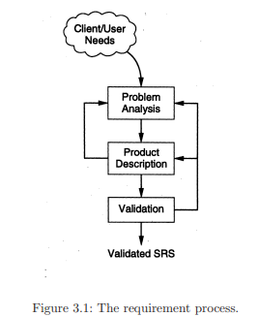

Slide 6
Requirements Specification
The final output is the SRS document.

Slide 7
Desirable Characteristics of an SRS
To properly satisfy the basic goals, an SRS should have certain properties and should contain different types of requirements
1. Correct
2. Complete
3. Unambiguous
4. Verifiable
5. Consistent
6. Ranked for importance and/or stability

Slide 8
Components of an SRS
The basic issues an SRS must address are:
– Functionality
– Performance
– Design constraints imposed on an implementation
– External interfaces

Slide 9
Structure of a Requirements Document

